Slide 1

William Stallings, Computer Organization and Architecture, 9th Edition
Chapter 4
Cache Memory
Notes:
Lecture slides prepared for “Computer Organization and Architecture”, 9/e, by William Stallings, Chapter 4 “Cache Memory”.
Adapted by Thân Văn Sử

Slide 2
Objectives
How are internal memory elements of a computer structured?
After studying this chapter, you should be able to:
  Present an overview of the main characteristics of computer memory systems and the use of a memory hierarchy.
  Describe the basic concepts and intent of cache memory. Discuss the key elements of cache design.
  Distinguish among direct mapping, associative mapping, and set-associative mapping.
  Explain the reasons for using multiple levels of cache.
  Understand the performance implications of multiple levels of memory.
Notes:
Intent: mục đích,mục tiêu
The term location in Table 4.1 refers to whether memory is internal and external
to the computer. Internal memory is often equated with main memory. But there
are other forms of internal memory. The processor requires its own local memory, in
the form of registers (e.g., see Figure 2.3). Further, as we shall see, the control unit
portion of the processor may also require its own internal memory. We will defer
discussion of these latter two types of internal memory to later chapters. Cache is
another form of internal memory. External memory consists of peripheral storage
devices, such as disk and tape, that are accessible to the processor via I/O controllers.
An obvious characteristic of memory is its capacity. For internal memory, this is
typically expressed in terms of bytes (1 byte = 8 bits) or words. Common word lengths
are 8, 16, and 32 bits. External memory capacity is typically expressed in terms of bytes.
A related concept is the unit of transfer. For internal memory, the unit
of transfer is equal to the number of electrical lines into and out of the memory
module. This may be equal to the word length, but is often larger, such as 64, 128, or
256 bits. To clarify this point, consider three related concepts for internal memory:
• Word: The “natural” unit of organization of memory. The size of a word is typically
equal to the number of bits used to represent an integer and to the instruction
length. Unfortunately, there are many exceptions. For example, the CRAY
C90 (an older model CRAY supercomputer) has a 64-bit word length but uses
a 46-bit integer representation. The Intel x86 architecture has a wide variety of
instruction lengths, expressed as multiples of bytes, and a word size of 32 bits.
• Addressable units: In some systems, the addressable unit is the word. However,
many systems allow addressing at the byte level. In any case, the relationship
between the length in bits A of an address and the number N of addressable
units is 2A = N.
• Unit of transfer: For main memory, this is the number of bits read out of or
written into memory at a time. The unit of transfer need not equal a word or
an addressable unit. For external memory, data are often transferred in much
larger units than a word, and these are referred to as blocks

Slide 3
Contents
4.1- Computer Memory Systems Overview
4.2- Cache Memory Principles
4.3- Elements of Cache Design
Notes:
The term location in Table 4.1 refers to whether memory is internal and external
to the computer. Internal memory is often equated with main memory. But there
are other forms of internal memory. The processor requires its own local memory, in
the form of registers (e.g., see Figure 2.3). Further, as we shall see, the control unit
portion of the processor may also require its own internal memory. We will defer
discussion of these latter two types of internal memory to later chapters. Cache is
another form of internal memory. External memory consists of peripheral storage
devices, such as disk and tape, that are accessible to the processor via I/O controllers.
An obvious characteristic of memory is its capacity. For internal memory, this is
typically expressed in terms of bytes (1 byte = 8 bits) or words. Common word lengths
are 8, 16, and 32 bits. External memory capacity is typically expressed in terms of bytes.
A related concept is the unit of transfer. For internal memory, the unit
of transfer is equal to the number of electrical lines into and out of the memory
module. This may be equal to the word length, but is often larger, such as 64, 128, or
256 bits. To clarify this point, consider three related concepts for internal memory:
• Word: The “natural” unit of organization of memory. The size of a word is typically
equal to the number of bits used to represent an integer and to the instruction
length. Unfortunately, there are many exceptions. For example, the CRAY
C90 (an older model CRAY supercomputer) has a 64-bit word length but uses
a 46-bit integer representation. The Intel x86 architecture has a wide variety of
instruction lengths, expressed as multiples of bytes, and a word size of 32 bits.
• Addressable units: In some systems, the addressable unit is the word. However,
many systems allow addressing at the byte level. In any case, the relationship
between the length in bits A of an address and the number N of addressable
units is 2A = N.
• Unit of transfer: For main memory, this is the number of bits read out of or
written into memory at a time. The unit of transfer need not equal a word or
an addressable unit. For external memory, data are often transferred in much
larger units than a word, and these are referred to as blocks

Slide 4
4.1- Computer Memory System Overview
Characteristics of Memory System.
The Memory Hierarchy
Notes:
The term location in Table 4.1 refers to whether memory is internal and external
to the computer. Internal memory is often equated with main memory. But there
are other forms of internal memory. The processor requires its own local memory, in
the form of registers (e.g., see Figure 2.3). Further, as we shall see, the control unit
portion of the processor may also require its own internal memory. We will defer
discussion of these latter two types of internal memory to later chapters. Cache is
another form of internal memory. External memory consists of peripheral storage
devices, such as disk and tape, that are accessible to the processor via I/O controllers.
An obvious characteristic of memory is its capacity. For internal memory, this is
typically expressed in terms of bytes (1 byte = 8 bits) or words. Common word lengths
are 8, 16, and 32 bits. External memory capacity is typically expressed in terms of bytes.
A related concept is the unit of transfer. For internal memory, the unit
of transfer is equal to the number of electrical lines into and out of the memory
module. This may be equal to the word length, but is often larger, such as 64, 128, or
256 bits. To clarify this point, consider three related concepts for internal memory:
• Word: The “natural” unit of organization of memory. The size of a word is typically
equal to the number of bits used to represent an integer and to the instruction
length. Unfortunately, there are many exceptions. For example, the CRAY
C90 (an older model CRAY supercomputer) has a 64-bit word length but uses
a 46-bit integer representation. The Intel x86 architecture has a wide variety of
instruction lengths, expressed as multiples of bytes, and a word size of 32 bits.
• Addressable units: In some systems, the addressable unit is the word. However,
many systems allow addressing at the byte level. In any case, the relationship
between the length in bits A of an address and the number N of addressable
units is 2A = N.
• Unit of transfer: For main memory, this is the number of bits read out of or
written into memory at a time. The unit of transfer need not equal a word or
an addressable unit. For external memory, data are often transferred in much
larger units than a word, and these are referred to as blocks

Slide 5
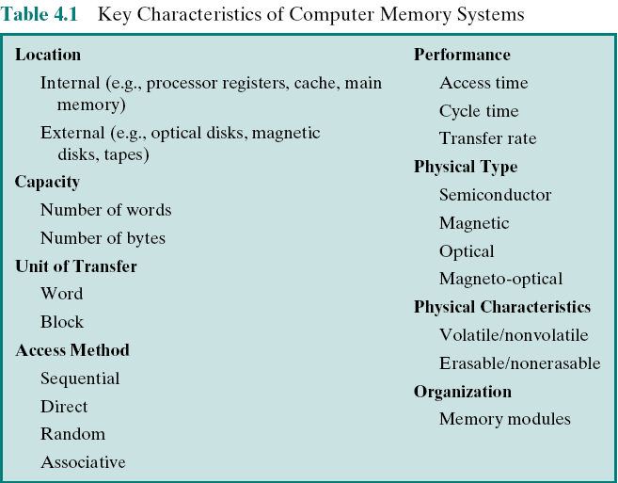
Key Characteristics of Computer Memory Systems
Notes:
Associative: liên kết,kết hợp
A magneto-optical drive is a kind of optical disc drive capable of writing and rewriting data upon a magneto-optical disc. Both 130 mm and 90 mm form factors
The complex subject of computer memory is made more manageable if we classify
memory systems according to their key characteristics. The most important of these
are listed in Table 4.1.

Slide 6
Characteristics of Memory Systems
Location
  Refers to whether memory is internal and external to the computer
  Internal memory is often equated (make equal) with main memory
  Processor requires its own local memory, in the form of registers
  Cache is another form of internal memory
  External memory consists of peripheral storage devices that are accessible to the processor via I/O controllers
Capacity
  Memory is typically expressed in terms of bytes
Unit of transfer
  For internal memory the unit of transfer is equal to the number of electrical lines into and out of the memory module
Notes:
Expressed : thể hiện
The term location in Table 4.1 refers to whether memory is internal and external
to the computer. Internal memory is often equated with main memory. But there
are other forms of internal memory. The processor requires its own local memory, in
the form of registers (e.g., see Figure 2.3). Further, as we shall see, the control unit
portion of the processor may also require its own internal memory. We will defer
discussion of these latter two types of internal memory to later chapters. Cache is
another form of internal memory. External memory consists of peripheral storage
devices, such as disk and tape, that are accessible to the processor via I/O controllers.
An obvious characteristic of memory is its capacity. For internal memory, this is
typically expressed in terms of bytes (1 byte = 8 bits) or words. Common word lengths
are 8, 16, and 32 bits. External memory capacity is typically expressed in terms of bytes.
A related concept is the unit of transfer. For internal memory, the unit
of transfer is equal to the number of electrical lines into and out of the memory
module. This may be equal to the word length, but is often larger, such as 64, 128, or
256 bits. To clarify this point, consider three related concepts for internal memory:
• Word: The “natural” unit of organization of memory. The size of a word is typically
equal to the number of bits used to represent an integer and to the instruction
length. Unfortunately, there are many exceptions. For example, the CRAY
C90 (an older model CRAY supercomputer) has a 64-bit word length but uses
a 46-bit integer representation. The Intel x86 architecture has a wide variety of
instruction lengths, expressed as multiples of bytes, and a word size of 32 bits.
• Addressable units: In some systems, the addressable unit is the word. However,
many systems allow addressing at the byte level. In any case, the relationship
between the length in bits A of an address and the number N of addressable
units is 2A = N.
• Unit of transfer: For main memory, this is the number of bits read out of or
written into memory at a time. The unit of transfer need not equal a word or
an addressable unit. For external memory, data are often transferred in much
larger units than a word, and these are referred to as blocks

Slide 7
Method of Accessing Units of Data
Sequential access
Memory is organized into units of data called records
Access must be made in a specific linear sequence
Access time is variable
Direct access
Involves a shared read-write mechanism
Individual blocks or records have a unique address based on physical location
Access time is variable
Random access
Each addressable location in memory has a unique, physically wired-in addressing mechanism
The time to access a given location is independent of the sequence of prior accesses and is constant
Any location can be selected at random and directly addressed and accessed
Main memory and some cache systems are random access
Associative
A word is retrieved based on a portion of its contents rather than its address
Each location has its own addressing mechanism and retrieval time is constant independent of location or prior access patterns
Cache memories may employ associative access
More details: Next slides
Notes:
Associative: liên kết ,kêt họp
Another distinction among memory types is the method of accessing units of
data. These include the following:
• Sequential access: Memory is organized into units of data, called records.
Access must be made in a specific linear sequence. Stored addressing information
is used to separate records and assist in the retrieval process. A shared
read–write mechanism is used, and this must be moved from its current location
to the desired location, passing and rejecting each intermediate record.
Thus, the time to access an arbitrary record is highly variable. Tape units, discussed
in Chapter 6, are sequential access.
Direct access: As with sequential access, direct access involves a shared
read–write mechanism. However, individual blocks or records have a unique
address based on physical location. Access is accomplished by direct access
to reach a general vicinity plus sequential searching, counting, or waiting to
reach the final location. Again, access time is variable. Disk units, discussed in
Chapter 6, are direct access.
• Random access: Each addressable location in memory has a unique, physically
wired-in addressing mechanism. The time to access a given location is independent
of the sequence of prior accesses and is constant. Thus, any location
can be selected at random and directly addressed and accessed. Main memory
and some cache systems are random access.
• Associative: This is a random access type of memory that enables one to make
a comparison of desired bit locations within a word for a specified match, and
to do this for all words simultaneously. Thus, a word is retrieved based on a
portion of its contents rather than its address. As with ordinary random-access
memory, each location has its own addressing mechanism, and retrieval time
is constant independent of location or prior access patterns. Cache memories
may employ associative access.

Slide 8
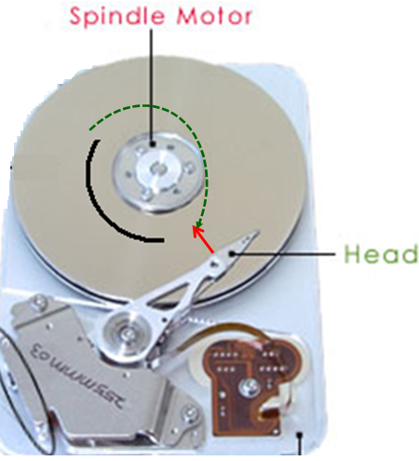
Method of Accessing Units of Data:
Direct Access
Location of each sector is idenfified by a unique number
T1: seek time, time for moving the head to the accessed track
T2: Rotational delay, time for rotating the disk to position the head to the beginning of the accessed sector
T3: Transfer time, time for rotating the disk to access all the accessed sector
Access time = T1 + T2 + T3
Each sector is accessed using different access time

Slide 9
Method of Accessing Units of Data:
Random Access
CPU
Mem. Decoder
Address bus
The time to access a given location is independent of the sequence of prior accesses and is constant
Main memory
Notes:
Prior : trước

Slide 10
Capacity and Performance:
The two most important characteristics of memory
Three performance parameters are used:
Access time (latency)
For random-access memory it is the time it takes to perform a read or write operation
For non-random-access memory it is the time it takes to position the read-write mechanism at the desired location
Memory cycle time
Access time plus any additional time required before second access can commence
Additional time may be required for transients to die out on signal lines or to regenerate data if they are read destructively
Concerned with the system bus, not the processor
Transfer rate
The rate at which data can be transferred into or out of a memory unit
For random-access memory it is equal to 1/(cycle time)
Notes:
Commence: bat đầu ,khởi đầu
From a user’s point of view, the two most important characteristics of memory
are capacity and performance. Three performance parameters are used:
• Access time (latency): For random-access memory, this is the time it takes to
perform a read or write operation, that is, the time from the instant that an
address is presented to the memory to the instant that data have been stored
or made available for use. For non-random-access memory, access time is the
time it takes to position the read–write mechanism at the desired location.
• Memory cycle time: This concept is primarily applied to random-access memory
and consists of the access time plus any additional time required before a second
access can commence. This additional time may be required for transients to die
out on signal lines or to regenerate data if they are read destructively. Note that
memory cycle time is concerned with the system bus, not the processor.
• Transfer rate: This is the rate at which data can be transferred into or out of a
memory unit. For random-access memory, it is equal to 1/(cycle time).

Slide 11
Memory
  The most common forms are:
  Semiconductor memory
  Magnetic surface memory
  Optical
  Magneto-optical
  Several physical characteristics of data storage are important:
  Volatile memory
    Information decays naturally or is lost when electrical power is switched off
  Nonvolatile memory
    Once recorded, information remains without deterioration until deliberately changed
    No electrical power is needed to retain information
  Magnetic-surface memories : Are nonvolatile
  Semiconductor memory : May be either volatile or nonvolatile
  Nonerasable memory
    Cannot be altered, except by destroying the storage unit
    Semiconductor memory of this type is known as read-only memory (ROM)
  For random-access memory the organization is a key design issue
  Organization refers to the physical arrangement of bits to form words
Notes:
A variety of physical types of memory have been employed. The most common
today are semiconductor memory, magnetic surface memory, used for disk and
tape, and optical and magneto-optical.
Several physical characteristics of data storage are important. In a volatile
memory, information decays naturally or is lost when electrical power is switched
off. In a nonvolatile memory, information once recorded remains without deterioration
until deliberately changed; no electrical power is needed to retain information.
Magnetic-surface memories are nonvolatile. Semiconductor memory (memory
on integrated circuits) may be either volatile or nonvolatile. Nonerasable memory
cannot be altered, except by destroying the storage unit. Semiconductor memory of
this type is known as read-only memory (ROM). Of necessity, a practical nonerasable
memory must also be nonvolatile.
For random-access memory, the organization is a key design issue. In this context,
organization refers to the physical arrangement of bits to form words. The
obvious arrangement is not always used, as is explained in Chapter 5.

Slide 12
Memory Hierarchy
Design constraints on a computer’s memory can be summed up by three questions:
  How much, how fast, how expensive
There is a trade-off among capacity, access time, and cost
  Faster access time, greater cost per bit
  Greater capacity, smaller cost per bit
  Greater capacity, slower access time
The way out of the memory dilemma is not to rely on a single memory component or technology, but to employ a memory hierarchy
A great capacity memory but cheap and low speed + one or some small capacity memory but fast and more expensive (cache) .
Notes:
Dilemma : tinh trang khó xử
Trade-off : đánh đổi
The way out : lối thoát
To employ xử dụng, dùng
The design constraints on a computer’s memory can be summed up by three questions:
How much? How fast? How expensive?
The question of how much is somewhat open ended. If the capacity is there,
applications will likely be developed to use it. The question of how fast is, in a sense,
easier to answer. To achieve greatest performance, the memory must be able to
keep up with the processor. That is, as the processor is executing instructions, we
would not want it to have to pause waiting for instructions or operands. The final
question must also be considered. For a practical system, the cost of memory must
be reasonable in relationship to other components.
As might be expected, there is a trade-off among the three key characteristics
of memory: capacity, access time, and cost. A variety of technologies are used to
implement memory systems, and across this spectrum of technologies, the following
relationships hold:
• Faster access time, greater cost per bit
• Greater capacity, smaller cost per bit
• Greater capacity, slower access time
The dilemma facing the designer is clear. The designer would like to use memory
technologies that provide for large-capacity memory, both because the capacity
is needed and because the cost per bit is low. However, to meet performance
requirements, the designer needs to use expensive, relatively lower-capacity memories
with short access times.
The way out of this dilemma is not to rely on a single memory component or
technology, but to employ a memory hierarchy.

Slide 13
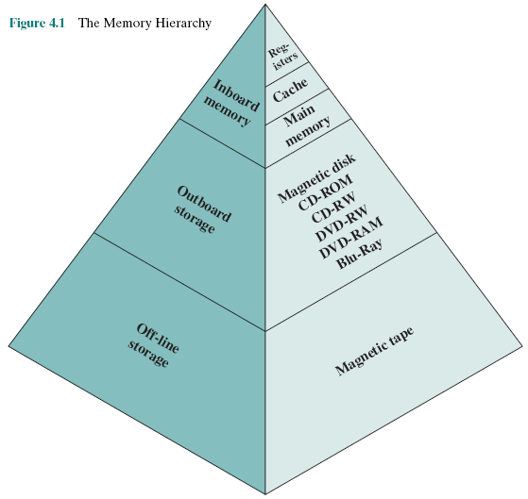
Memory Hierarchy…
Notes:
The design constraints on a computer’s memory can be summed up by three questions:
How much? How fast? How expensive?
The question of how much is somewhat open ended. If the capacity is there,
applications will likely be developed to use it. The question of how fast is, in a sense,
easier to answer. To achieve greatest performance, the memory must be able to
keep up with the processor. That is, as the processor is executing instructions, we
would not want it to have to pause waiting for instructions or operands. The final
question must also be considered. For a practical system, the cost of memory must
be reasonable in relationship to other components.
As might be expected, there is a trade-off among the three key characteristics
of memory: capacity, access time, and cost. A variety of technologies are used to
implement memory systems, and across this spectrum of technologies, the following
relationships hold:
• Faster access time, greater cost per bit
• Greater capacity, smaller cost per bit
• Greater capacity, slower access time
The dilemma facing the designer is clear. The designer would like to use memory
technologies that provide for large-capacity memory, both because the capacity
is needed and because the cost per bit is low. However, to meet performance
requirements, the designer needs to use expensive, relatively lower-capacity memories
with short access times.
The way out of this dilemma is not to rely on a single memory component or
technology, but to employ a memory hierarchy.

Slide 14
4.2- Cache Memory Principles
What is cache?
Cache and Main Memory

Slide 15
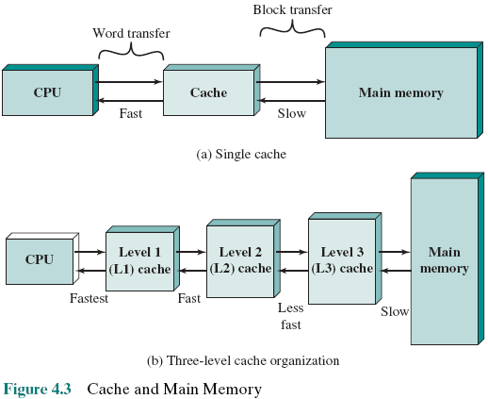
What is a Cache?
Memory Management Unit - MMU
Cache: A small size, expensive, memory which has high-speed access is located between CPU and RAM (large memory size, cheaper, and lower-speed
Memory).
L0: cache in CPU, working with CPU rate. It is not usually implemented.
Notes:
Cache memory is designed to combine the memory access time of expensive, high-speed
memory combined with the large memory size of less expensive, lower-speed
memory.
The concept is illustrated in Figure 4.3a. There is a relatively large and slow
main memory together with a smaller, faster cache memory. The cache contains a
copy of portions of main memory. When the processor attempts to read a word of
memory, a check is made to determine if the word is in the cache. If so, the word is
delivered to the processor. If not, a block of main memory, consisting of some fixed
number of words, is read into the cache and then the word is delivered to the processor.
Because of the phenomenon of locality of reference, when a block of data is
fetched into the cache to satisfy a single memory reference, it is likely that there will
be future references to that same memory location or to other words in the block.
Figure 4.3b depicts the use of multiple levels of cache. The L2 cache is slower
and typically larger than the L1 cache, and the L3 cache is slower and typically
larger than the L2 cache.

Slide 16
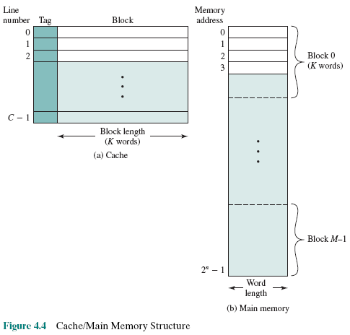
Cache/Main Memory Structure
Main memory is divided into the same size blocks. Some blocks will be loaded to cache.
Each line includes a tag that identifies which particular block is currently being stored
Address in cache is different from those in main memory → A mapping is needed.
Cache Addr → Main Mem Addr
Notes:
Mapping- ánh xạ: Cách gán ghép chủ quan, cố tính mỗi phần tử trong tập hợp A sẽ tương ứng với một phần tử duy nhất trong tập hợp B
Trong trường hợp này: A = tập các lines của cache, B: tập các blocks trong main memory. Mỗi line sẽ chứa nội dung của một block.
Tag là gì: Tag là dữ liệu, thông tin được đính kèm. Tag của mỗi line chứa dữ liệu cho biết nội dung của line này ứng với block nào trong main memory. Data trong tag mô tả ánh xạ từ Cache sang Memory
Tại sao mỗi line phải có phần tag?: Một line có thể chứa cả data lẫn intructions. Cache có dung lượng nhỏ nên chúng ta có thể hiểu việc chạy chương trình giống như cơ chế làm theo từng mẻ. Data trong cache chỉ mang tính tạm thời, data trong main memory mới là data chính thức. Như vậy, những data đã bị modified trong cache cần phải được cập nhật về main memory. Chính dữ liệu trong tag giúp việc cập nhật này được thực thi chình xác, dúng chỗ

Slide 17
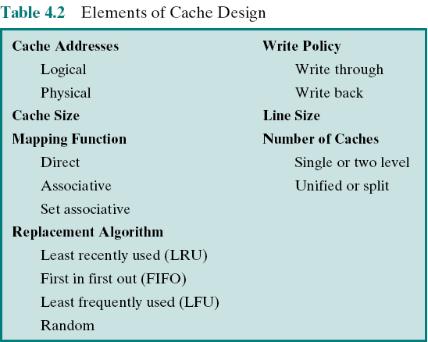
4.3- Elements of Cache Design
Overview of cache design parameters
Notes:
This section provides an overview of cache design parameters and reports some
typical results. We occasionally refer to the use of caches in high-performance computing
(HPC). HPC deals with supercomputers and their software, especially for
scientific applications that involve large amounts of data, vector and matrix computation,
and the use of parallel algorithms. Cache design for HPC is quite different
than for other hardware platforms and applications. Indeed, many researchers
have found that HPC applications perform poorly on computer architectures that
employ caches [BAIL93]. Other researchers have since shown that a cache hierarchy
can be useful in improving performance if the application software is tuned to
exploit the cache [WANG99, PRES01].
Although there are a large number of cache implementations, there are a few
basic design elements that serve to classify and differentiate cache architectures.
Table 4.2 lists key elements.

Slide 18
Main Memory Address Specifications
Opcode
Memory Add.
Physical Address
Abtract Address
Virtual Address
3010
3005
App
Physical Addresses
3005
CPU
PC=3010
3000
Mem. Of Operating System
Mem. Decoder
3005
Notes:
Memory for application is announced (3000 bytes if theis example).
Compiler will dertermine addresses in an application accordingly
All application content is loaded to the main memory
At a time, only one process runs.
P152 :cluster: cụm
P128 :phenomenon: hiện tượng

Slide 19
Main Memory Address Specifications
Abtract Addresses
When the operating system is upgraded, the OS needs more memory ( ex: 4000 bytes), old applications are not compatible.
Address must be specified by an other way to ensure that old programs can be run in new OS.
Abstract addresses
3005
OldApp.
4000
Mem. Of Operating System
3005
Notes:
Memory for application is announced (3000 bytes in this example).
Compiler will dertermine addresses in an application accordingly
All application contents are loaded to the main memory
At a time, only one process runs.

Slide 20
Main Memory Address Specifications
Abstract Addresses
All addresses in an application will be specified by compilers using an offset (difference) from the base address (position at which the app. is loaded)
A register (base register) must be added to maintain the base address of the process
➔ An address is specified by <base, offset)
5
4005
pp.
4000
Mem. Of Operating System
CPU
Mem.
Decoder
Base:4000
+
Add. bus
5
For example, suppose in a street, there are 10 identical houses with each of them having a width of 5 meters. If the first house starts 2 meters inside the street, then the 7th house will be (2 + 7*5) = 37 meter from the start of the street. Here (7*5) = 35 is the offset.
Notes:
An application can be loaded to any position of main memory
Suppose that a process is swapped to then swapped in, it can be loaded to a position which is different from initial position
When an application is allowed to run, all it’s content must be loaded to main memory
Offset is the distance between two points. In CS, offset is used to describe the distance between two memory locations.
For example, suppose in a street, there are 10 identical houses with each of them having a width of 5 meters. If the first house starts 2 meters inside the street, then the 7th house will be (2 + 7*5) = 37 meter from the start of the street. Here (7*5) = 35 is the offset.
Lets take a programming example. Suppose there’s an integer array: int arr[10];
Suppose the address (memory location) of arr[0] is L.
If sizeOf (Integer) = 4 bytes, then the i-th element of the array will have address: (L+ 4*i).
Here (4*i) is called the offset.

Slide 21
Main Memory Address Specifications
Virtual Addresses: Paging- Segmentation
Contemporary OSs allows many programs running concurrently although system’s memory is limited. Solution is that the program content and memory will be divided into some pages (same-size, ex: 4KB) or segments (different size). Only needed pages/segments are loaded to system memory.
➔Compilers must translate program’s addresses to a suitable form (virtual address). Virtual address format:
<page/segment, offset>
X=10
4
3
2
Address of X:
(3,4)
1
0
Notes:
Comtemporary: đồng thời
Figure 4.4 depicts the structure of a cache/main-memory system.

Slide 22
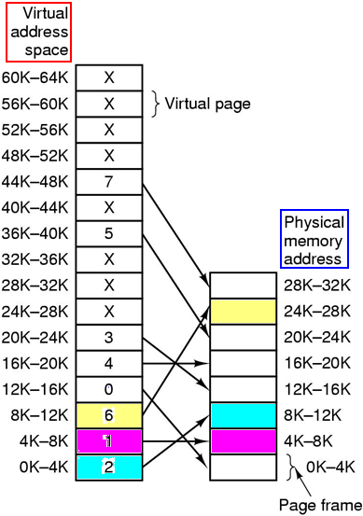
Main Memory Address Specifications
Virtual Addresses: Paging- Segmentation
When an instruction/data is accessed, physical address must be supplied. A mapping is needed as a mean for determining physical addresses from their virtual addresses. This mapping is implemented in OS as a page table.
A hardware is needed to translate virtual address to physical address→ MMU – Memory Management Unit.
Operating Systems - Tannenbaum
Notes:
Figure 4.4 depicts the structure of a cache/main-memory system.

Slide 23
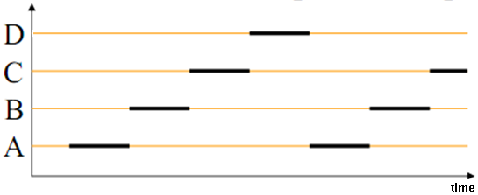
Main Memory Address Specifications
Virtual Addresses: Paging- Segmentation
Time-sharing
mechanism
How do OSs permit many program running concurrently? ➔ Only some pages/segments of a process are loaded and the time-sharing mechanism is applied.
Advantages of memory paging: Many apps can run concurrently in limited memory. A page of a program can loaded into arbitrary physical memory location.
- Disadvantages of memory paging: If a page fault occurs, cost must be paid when an in-memory frame must be swapped to disk from memory (swap out) then a page from disk will be loaded to memory (swap in) – Paging replacement.
Notes:
Figure 4.4 depicts the structure of a cache/main-memory system.
Arbitrary : bất kỳ

Slide 24
Cache Addresses: Virtual Address
Virtual memory
  Facility that allows programs to address memory from a logical point of view, without regard to the amount of main memory physically available. Only some needed small parts of a program are loaded to main memory at a time. So, a large program can run although memory size is smaller
  When used, the address fields of machine instructions contain virtual addresses
  For reads from and writes to main memory, a hardware memory management unit (MMU) translates each virtual address into a physical address in main memory
Notes:
Almost all non-embedded processors, and many embedded processors, support virtual
memory, a concept discussed in Chapter 8. In essence, virtual memory is a facility
that allows programs to address memory from a logical point of view, without
regard to the amount of main memory physically available. When virtual memory is
used, the address fields of machine instructions contain virtual addresses. For reads
to and writes from main memory, a hardware memory management unit (MMU)
translates each virtual address into a physical address in main memory.

Slide 25
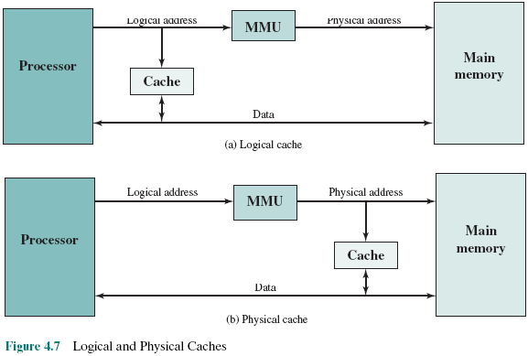
Logical and
Physical
Caches
Virtual/Logical cache stores data using virtual addresses
Physical cache stores data using physical addresses
Notes:
When virtual addresses are used, the system designer may choose to place the
cache between the processor and the MMU or between the MMU and main memory
(Figure 4.7). A logical cache, also known as a virtual cache, stores data using
virtual addresses. The processor accesses the cache directly, without going through
the MMU. A physical cache stores data using main memory physical addresses.
One obvious advantage of the logical cache is that cache access speed is faster
than for a physical cache, because the cache can respond before the MMU performs
an address translation. The disadvantage has to do with the fact that most virtual
memory systems supply each application with the same virtual memory address
space. That is, each application sees a virtual memory that starts at address 0. Thus,
the same virtual address in two different applications refers to two different physical
addresses. The cache memory must therefore be completely flushed with each
application context switch, or extra bits must be added to each line of the cache to
identify which virtual address space this address refers to.

Slide 26
Mapping Function
Because there are fewer cache lines than main memory blocks, an algorithm is needed for mapping main memory blocks into cache lines
Three techniques can be used:
Direct
The simplest technique
Maps each block of main memory into only one possible cache line
Associative
Permits each main memory block to be loaded into any line of the cache
The cache control logic interprets a memory address simply as a Tag and a Word field
To determine whether a block is in the cache, the cache control logic must simultaneously examine every line’s Tag for a match
Set Associative
A compromise that exhibits the strengths of both the direct and associative approaches while reducing their disadvantages
Read by yourself
Notes:
Because there are fewer cache lines than main memory blocks, an algorithm is
needed for mapping main memory blocks into cache lines. Further, a means is
needed for determining which main memory block currently occupies a cache line.
The choice of the mapping function dictates how the cache is organized. Three
techniques can be used: direct, associative, and set associative.
Direct mapping: The simplest technique, known as direct mapping, maps each
block of main memory into only one possible cache line.
Associative mapping: Associative mapping overcomes the disadvantage of direct
mapping by permitting each main memory block to be loaded into any line of the
cache.
Set-associative mapping: Set-associative mapping is a compromise that
exhibits the strengths of both the direct and associative approaches while reducing
their disadvantages.

Slide 27
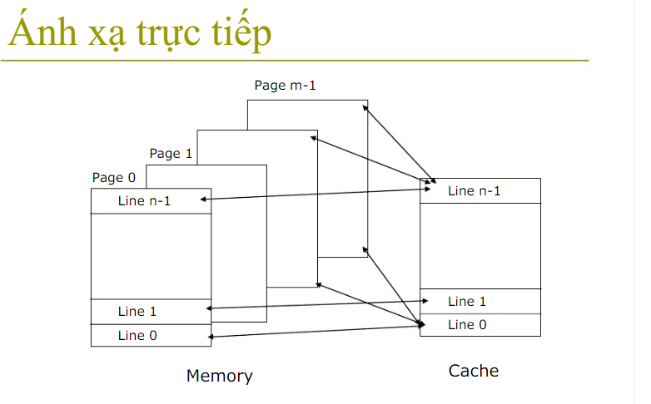

Slide 28
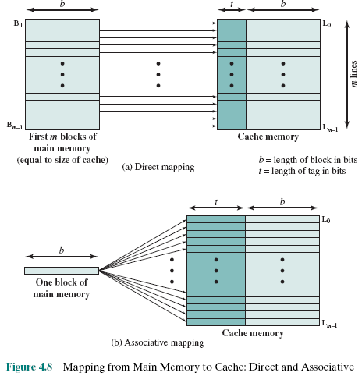
Direct
Mapping
The block j in main memory will be loaded to the line i of the cache: i = j mode m
A block in main memory can be load to any line of the cache
Notes:
The mapping is expressed as
i = j modulo m
where
i = cache line number
j = main memory block number
m = number of lines in the cache
Figure 4.8a shows the mapping for the first m blocks of main memory. Each
block of main memory maps into one unique line of the cache. The next m blocks
of main memory map into the cache in the same fashion; that is, block B_{m} of main
memory maps into line L₀ of cache, block _{Bm+1} maps into line L₁, and so on.
Yếu điểm chính của kỹ thuật direct mapping (cà ri dê nguyên tô) là khi có cache miss
(thí dụ cần truy xuất một biến ở khối m trong hình (a)),
phải đổ hết cache về bộ nhớ rồi lại chép cả một khới lớn các blocks từ mem và cache
Để giảm chi phí chép qua qua lại mem-cache quá nhiều, kỹ thuật associative được dùng.
Khi gặp cahe miss, phải chép 1 block vào cache nhưng không có line nào trống. Bài toán ở
đây là line nào phải hi sinh, được chuyển về mem, nhường chỗ cho block mới. Việc này sẽ được
Giải quyết trong phần replacement algorithms – các slide sau.

Slide 29
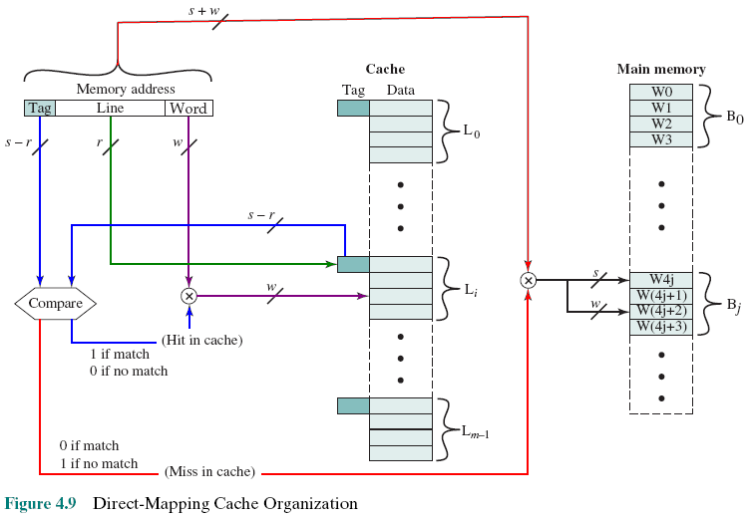
Direct Mapping Cache Organization
READ BY YOURSELF
s: Block index
r: Line index
w: word index
penalty
Notes:
Cache hit: an address of read word is in cache
Cache miss: an address of read word is not in cache
Cấu trúc một địa chỉ bộ nhớ được truy xuất dùng cache: <Tag, Line, Word> mang nghĩa là địa chỉ này thuộc về block nào trên bộ nhớ chính (tag),
dòng thứ mấy của cache, từ thứ mấy trong dòng này
Bước 1: Đọ (Compare) 2 giá trị Tag (đường mầu blue)
Bước 2: Nếu 2 trị này bằng nhau (hit), địa chỉ này có trong cache rồi, dựa vào Line (mầu green) để xác định line trong cache và Word (mầu tím) xác định được địa chỉ (word thứ mất trong line này) của ô nhớ cần đọc
Bước 3: Ngược lại, địa chỉ cần truy xuất chưa nằm trong cache (mầu đỏ) mà nằm trong bộ nhớ, thông qua Tag, đến bộ nhớ để mang block này vào cache sau khi đã đẩy 1 line ra khỏi cache (victim line) – Replacement algorithms (cuối chương)

Slide 30
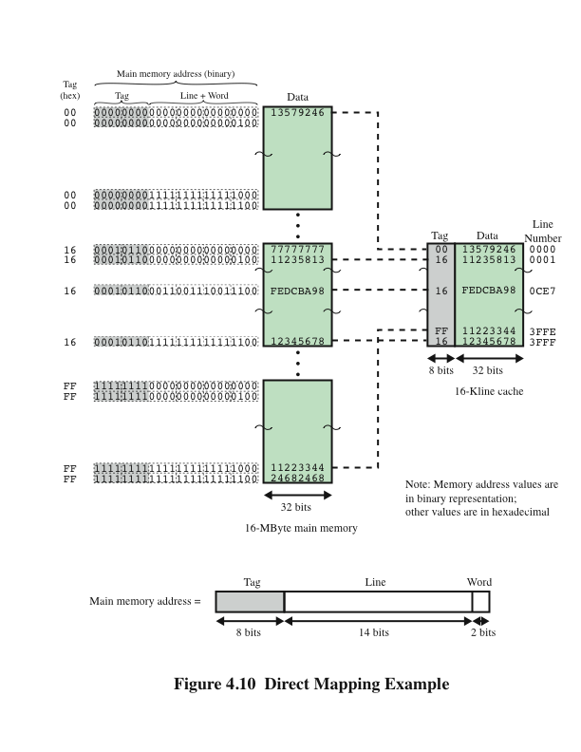
Direct
Mapping
Example
READ BY YOURSELF
Notes:
Figure 4.10 Direct Mapping Example.

Slide 31

Direct Mapping Summary
READ BY YOURSELF
Address length = (s + w) bits
Number of addressable units = 2^{s+w} words or bytes
Block size = line size = 2^{w} words or bytes
Number of blocks in main memory = 2^{s+ w}/2^{w} = 2^{s}
Number of lines in cache = m = 2r
Size of tag = (s – r) bits
Notes:
The direct mapping technique is simple and inexpensive to implement. Its
main disadvantage is that there is a fixed cache location for any given block. Thus,
if a program happens to reference words repeatedly from two different blocks that
map into the same line, then the blocks will be continually swapped in the cache,
and the hit ratio will be low (a phenomenon known as thrashing).

Slide 32

Victim Cache
READ BY YOURSELF
  Originally proposed as an approach to reduce the conflict misses of direct mapped caches without affecting its fast access time
Fully associative cache
Typical size is 4 to 16 cache lines
Residing between direct mapped L1 cache and the next level of memory
Notes:
One approach to lower the miss penalty is to remember what was discarded
in case it is needed again. Since the discarded data has already been fetched, it can
be used again at a small cost. Such recycling is possible using a victim cache. Victim
cache was originally proposed as an approach to reduce the conflict misses of direct
mapped caches without affecting its fast access time. Victim cache is a fully associative
cache, whose size is typically 4 to 16 cache lines, residing between a direct mapped L1
cache and the next level of memory. This concept is explored in Appendix D.

Slide 33
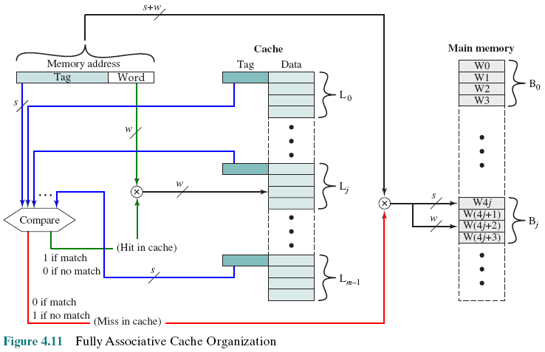
Fully Associative Cache Organization
READ BY YOURSELF
A block can be loaded to any cache line
Compare to each Tag
Notes:
Associative mapping overcomes the disadvantage of direct
mapping by permitting each main memory block to be loaded into any line of the
cache (Figure 4.8b). In this case, the cache control logic interprets a memory address
simply as a Tag and a Word field. The Tag field uniquely identifies a block of main
memory. To determine whether a block is in the cache, the cache control logic must
simultaneously examine every line’s tag for a match. Figure 4.11 illustrates the logic.

Slide 34
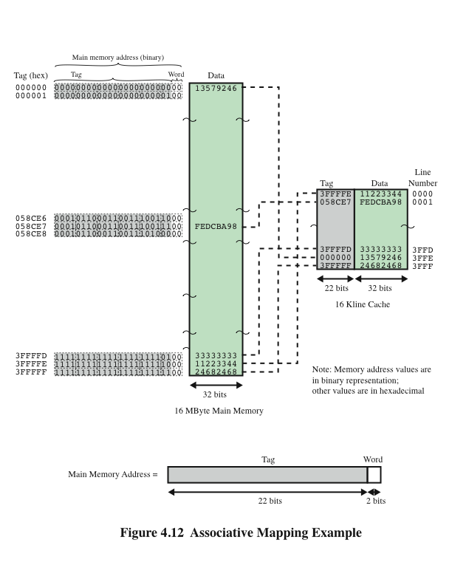
Associative
Mapping
Example
READ BY YOURSELF
Notes:
Figure 4.12 Associative Mapping Example.

Slide 35
Associative Mapping Summary
READ BY YOURSELF
Address length = (s + w) bits
Number of addressable units = 2^{s+w} words or bytes
Block size = line size = 2^{w} words or bytes
Number of blocks in main memory= 2^{s+ w}/2^{w} = 2^{s}
Number of lines in cache = undetermined
Size of tag = s bits
Notes:
With associative mapping, there is flexibility as to which block to replace when
a new block is read into the cache. Replacement algorithms, discussed later in this
section, are designed to maximize the hit ratio. The principal disadvantage of associative
mapping is the complex circuitry required to examine the tags of all cache
lines in parallel.

Slide 36
Set Associative Mapping
READ BY YOURSELF
Compromise (thỏa hiệp) that exhibits the strengths of both the direct and associative approaches while reducing their disadvantages
Cache consists of a number of sets
Each set contains a number of lines
A given block maps to any line in a given set
e.g. 2 lines per set
  2 way associative mapping
  A given block can be in one of 2 lines in only one set
Go to Replacement Algorithms
Notes:
Set-associative mapping is a compromise that
exhibits the strengths of both the direct and associative approaches while reducing
their disadvantages.
In this case, the cache consists of a number sets, each of which consists of a
number of lines. The relationships are
m = v* k
i = j modulo v
where
i = cache set number
j = main memory block number
m = number of lines in the cache
v = number of sets
k = number of lines in each set
This is referred to as k-way set-associative mapping.

Slide 37
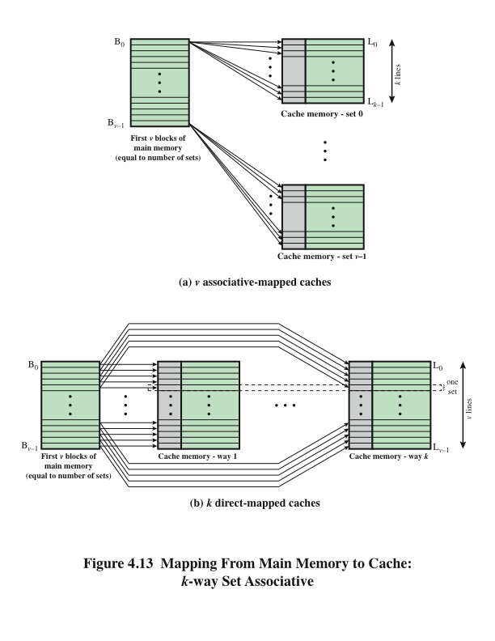
Mapping From Main Memory to Cache: k-Way
Set Associative
READ BY YOURSELF
Notes:
Figure 4.13a illustrates
this mapping for the first v blocks of main memory. As with associative mapping,
each word maps into multiple cache lines. For set-associative mapping, each word
maps into all the cache lines in a specific set, so that main memory block B₀ maps
into set 0, and so on. Thus, the set-associative cache can be physically implemented
as n associative caches. It is also possible to implement the set-associative cache as
k direct mapping caches, as shown in Figure 4.13b. Each direct-mapped cache is
referred to as a way, consisting of v lines. The first v lines of main memory are direct
mapped into the v lines of each way; the next group of v lines of main memory are
similarly mapped, and so on. The direct-mapped implementation is typically used
for small degrees of associativity (small values of k) while the associative-mapped
implementation is typically used for higher degrees of associativity [JACO08].

Slide 38
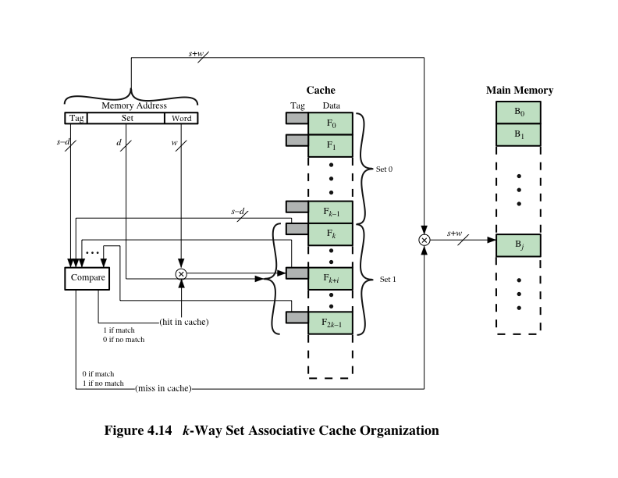
k-Way
Set Associative Cache Organization
READ BY YOURSELF
Notes:
For set-associative mapping, the cache control logic interprets a memory
address as three fields: Tag, Set, and Word. The d set bits specify one of v = 2^{d} sets.
The s bits of the Tag and Set fields specify one of the 2^{s} blocks of main memory.
Figure 4.14 illustrates the cache control logic. With fully associative mapping, the
tag in a memory address is quite large and must be compared to the tag of every line
in the cache. With k-way set-associative mapping, the tag in a memory address is
much smaller and is only compared to the k tags within a single set.

Slide 39
Set Associative Mapping Summary
READ BY YOURSELF
Address length = (s + w) bits
Number of addressable units = 2^{s+w} words or bytes
Block size = line size = 2^{w} words or bytes
Number of blocks in main memory = 2^{s+w/}2^{w=}2^{s}
Number of lines in set = k
Number of sets = v = 2^{d}
Number of lines in cache = m=kv = k * 2^{d}
Size of cache = k * 2^{d+w}words or bytes
Size of tag = (s – d) bits
Notes:
Set Associative Mapping Summary.

Slide 40
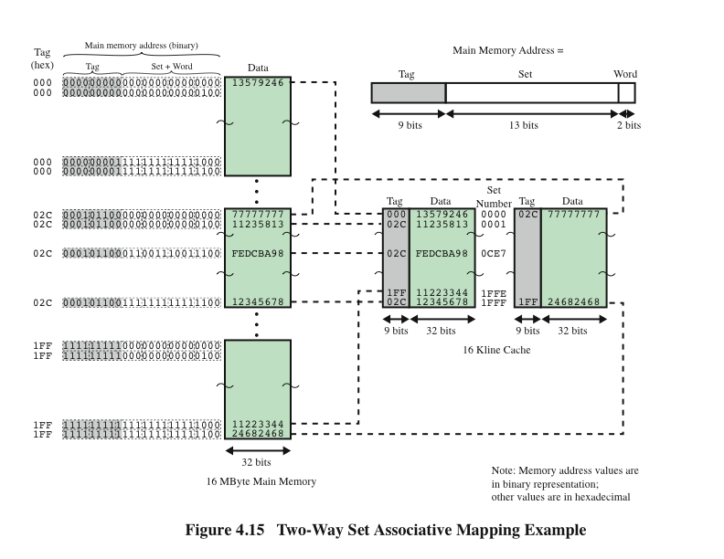
READ BY YOURSELF
Notes:
Figure 4.15 shows an example using set-associative mapping with two
lines in each set, referred to as two-way set-associative.

Slide 41
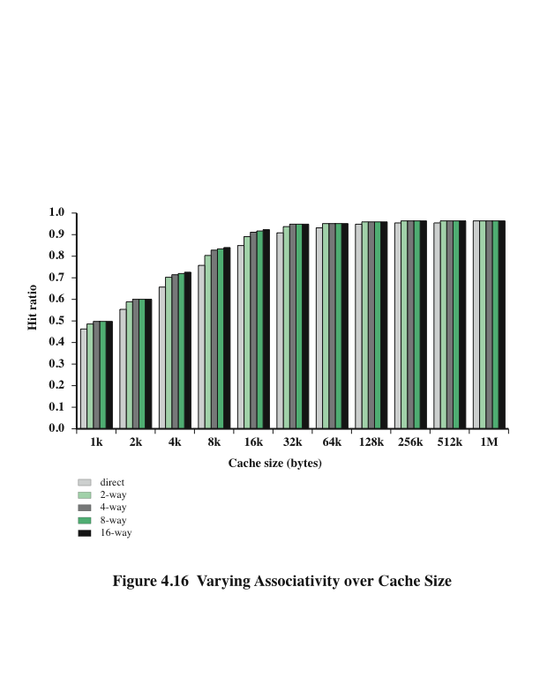
Varying Associativity Over Cache Size
READ BY YOURSELF
Notes:
Figure 4.16 shows the results of one simulation study of set-associative cache
performance as a function of cache size [GENU04]. The difference in performance
between direct and two-way set associative is significant up to at least a cache size of
64 kB. Note also that the difference between two-way and four-way at 4 kB is much
less than the difference in going from for 4 kB to 8 kB in cache size. The complexity
of the cache increases in proportion to the associativity, and in this case would not
be justifiable against increasing cache size to 8 or even 16 Kbytes. A final point to
note is that beyond about 32 kB, increase in cache size brings no significant increase
in performance.
The results of Figure 4.16 are based on simulating the execution of a GCC
compiler. Different applications may yield different results. For example, [CANT01]
reports on the results for cache performance using many of the CPU2000 SPEC
benchmarks. The results of [CANT01] in comparing hit ratio to cache size follow
the same pattern as Figure 4.16, but the specific values are somewhat different.

Slide 42
Replacement Algorithms
Two situations:
  Cache hit: Accessed address exists in cache
  Cache miss: Accessed address does not exist in cache. The memory block containing it must be loaded to the cache
Once the cache has been filled, when a new block is brought into the cache, one of the existing blocks must be replaced
For direct mapping there is only one possible line for any particular block and no choice is possible
For the associative and set-associative techniques a replacement algorithm is needed
To achieve high speed, an algorithm must be implemented in hardware
Notes:
Khi bộ nhớ cache đã được lấp đầy, khi một khối mới được đưa vào bộ nhớ cache, một trong những khối hiện có phải được thay thế.
Đối với bản đồ trực tiếp chỉ có một dòng có thể cho bất kỳ khối cụ thể nào và không có lựa chọn nào là có thể.
Đối với các kỹ thuật liên kết và liên kết thiết lập, một thuật toán thay thế là cần thiết
Để đạt được tốc độ cao, một thuật toán phải được thực hiện trong phần cứng.

Slide 43
The four most common replacement algorithms are:
Least recently used (LRU)
  Most effective
  Replace that block in the set that has been in the cache longest with no reference to it
  Because of its simplicity of implementation, LRU is the most popular replacement algorithm
First-in-first-out (FIFO)
  Replace that block in the set that has been in the cache longest
  Easily implemented as a round-robin or circular buffer technique
Least frequently used (LFU)
  Replace that block in the set that has experienced the fewest references
  Could be implemented by associating a counter with each line
2 bits in tag can be used: 00, 01, 10, 11. Line with 00 should be swap out. See the note.
Notes:
Ít được sử dụng gần đây nhất (LRU)
Hiệu quả nhất
Thay thế khối đó trong tập hợp đã ở trong bộ nhớ cache lâu nhất mà không có tham chiếu đến nó
Do tính đơn giản của việc triển khai, LRU là thuật toán thay thế phổ biến nhất.
First-in-first-out (FIFO) Thay thế khối đó trong tập hợp đã ở trong bộ nhớ cache dài nhất Dễ dàng thực hiện như một kỹ thuật đệm tròn hoặc tròn
Ít được sử dụng nhất (LFU)
Thay thế khối đó trong tập hợp đã trải qua ít tài liệu tham khảo nhất
Có thể được thực hiện bằng cách liên kết một quầy với mỗi dòng

Slide 44
Write Policy
When a block that is resident in the cache is to be replaced there are two cases to consider:
If the old block in the cache has not been altered then it may be overwritten with a new block without first writing out the old block
If at least one write operation has been performed on a word in that line of the cache then main memory must be updated by writing the line of cache out to the block of memory before bringing in the new block
There are two problems to contend (đấu tranh) with:
More than one device may have access to main memory
A more complex problem occurs when multiple processors are attached to the same bus and each processor has its own local cache - if a word is altered in one cache it could conceivably invalidate a word in other caches
Notes:
Khi một khối cư trú trong bộ nhớ cache được thay thế, có hai trường hợp cần xem xét
Nếu khối cũ trong bộ nhớ cache không bị thay đổi thì nó có thể được ghi đè với một khối mới mà không cần viết ra khối cũ trước.
Nếu ít nhất một thao tác ghi đã được thực hiện trên một từ trong dòng bộ nhớ cache đó thì bộ nhớ chính phải được cập nhật bằng cách viết dòng bộ nhớ cache ra khối bộ nhớ trước khi đưa vào khối mới
Có hai vấn đề để tranh luận (đấu tranh) với:
Nhiều hơn một thiết bị có thể có quyền truy cập vào bộ nhớ chính
Một vấn đề phức tạp hơn xảy ra khi nhiều bộ xử lý được gắn vào cùng một bus và mỗi bộ xử lý có bộ nhớ cache cục bộ riêng - nếu một từ bị thay đổi trong một bộ nhớ cache, nó có thể vô hiệu hóa một từ trong các bộ nhớ cache khác.

Slide 45
Write Through and Write Back
Write through- Ghi thẳng
  Simplest technique
  All write operations are made to main memory as well as to the cache
  The main disadvantage of this technique is that it generates substantial (heavy) memory traffic and may create a bottleneck
Write back-Ghi ngầm
  Minimizes memory writes
  Updates are made only in the cache
  Portions of main memory are invalid and hence accesses by I/O modules can be allowed only through the cache
  This makes for complex circuitry and a potential bottleneck
Notes:
Write through- Ghi thẳng
Kỹ thuật đơn giản nhất
Tất cả các thao tác ghi được thực hiện cho bộ nhớ chính cũng như bộ nhớ cache
Nhược điểm chính của kỹ thuật này là nó tạo ra lưu lượng bộ nhớ đáng kể (nặng) và có thể tạo ra một nút cổ chai.
Write back-Ghi ngầm
Potential: tiềm năng,khả năng
Hence: kể từ đây
Giảm thiểu ghi nhớ
Các bản cập nhật chỉ được thực hiện trong bộ nhớ cache
Các phần của bộ nhớ chính không hợp lệ và do đó truy cập bởi các mô-đun I / O chỉ có thể được phép thông qua bộ nhớ cache
Điều này làm cho mạch phức tạp và một nút thắt tiềm năng

Slide 46
Line Size
When a block of data is retrieved and placed in the cache not only the desired word but also some number of adjacent words are retrieved
As the block size increases the hit ratio will at first increase because of the principle of locality
As the block size increases more useful data are brought into the cache
The hit ratio will begin to decrease as the block becomes bigger and the probability of using the newly fetched information becomes less than the probability of reusing the information that has to be replaced
Two specific effects come into play:
Larger blocks reduce the number of blocks that fit into a cache
As a block becomes larger each additional word is farther from the requested word
Larger line size → More data → Cache hit increases, but expensive and more data in cache but not used (Normal: 64-128 bytes)
Notes:
Khi một khối dữ liệu được truy xuất và đặt trong bộ nhớ cache không chỉ từ mong muốn mà còn một số từ liền kề được truy xuất
Khi quy mô kich thuoc tăng tỷ lệ Hit lúc đầu sẽ tăng lên vì nguyên tắc của cuc bo
Khi kích thước khối tăng lên, dữ liệu hữu ích hơn được đưa vào bộ nhớ cache
Tỷ lệ Hit sẽ bắt đầu giảm khi khối trở nên lớn hơn và xác suất sử dụng thông tin mới được lấy trở nên ít hơn xác suất sử dụng lại thông tin phải được thay thế.
Hai hiệu ứng cụ thể :
Các khối lớn hơn làm giảm số lượng khối phù hợp với bộ nhớ cache
Khi một khối trở nên lớn hơn, mỗi từ bổ sung cách xa từ được yêu cầu
Kích thước dòng lớn hơn → Nhiều dữ liệu hơn → Bộ nhớ cache tăng, nhưng đắt tiền và nhiều dữ liệu hơn trong bộ nhớ cache nhưng không được sử dụng (Bình thường: 64-128 byte

Slide 47
Multilevel Caches
As logic density has increased it has become possible to have a cache on the same chip as the processor
The on-chip cache reduces the processor’s external bus activity and speeds up execution time and increases overall system performance
  When the requested instruction or data is found in the on-chip cache, the bus access is eliminated
  On-chip cache accesses will complete appreciably faster than would even zero-wait state bus cycles
  During this period the bus is free to support other transfers
Two-level cache:
  Internal cache designated as level 1 (L1)
  External cache designated as level 2 (L2)
Potential savings due to the use of an L2 cache depends on the hit rates in both the L1 and L2 caches
The use of multilevel caches complicates all of the design issues related to caches, including size, replacement algorithm, and write policy
Notes:
Bộ nhớ cache đa cấp
Khi mật độ logic đã tăng lên, có thể có một bộ nhớ cache trên cùng một chip với bộ xử lý.
Bộ nhớ cache trên chip làm giảm hoạt động của bus bên ngoài của bộ xử lý và tăng tốc thời gian thực hiện và tăng hiệu suất hệ thống tổng thể
Khi instruction hoặc dữ liệu được yêu cầu được tìm thấy trong bộ nhớ cache trên chip, quyền truy cập xe buýt sẽ bị loại bỏ
Truy cập bộ nhớ cache trên chip sẽ hoàn thành nhanh hơn đáng kể so với chu kỳ
Trong thời gian này, xe buýt được miễn phí để hỗ trợ các phương thức chuyển khoản khác
Bộ nhớ cache hai cấp: Bộ đệm ẩn nội bộ được chỉ định là cấp 1 (L1) Bộ đệm ẩn bên ngoài được chỉ định là cấp độ 2 (L2)
Tiết kiệm tiềm năng do sử dụng bộ nhớ cache L2 phụ thuộc vào tỷ lệ trúng trong cả bộ nhớ cache L1 và L2
Việc sử dụng bộ nhớ cache đa cấp làm phức tạp tất cả các vấn đề thiết kế liên quan đến bộ nhớ cache, bao gồm kích thước, thuật toán thay thế và chính sách ghi

Slide 48
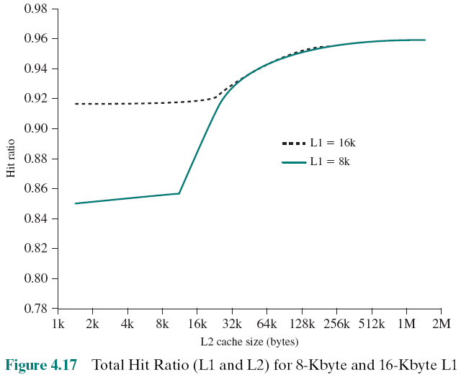
Hit Ratio (L1 & L2) For 8 Kbyte and 16Kbyte L1
Notes:
Figure 4.17 shows the results of one simulation study of two-level cache performance
as a function of cache size [GENU04]. The figure assumes that both
caches have the same line size and shows the total hit ratio. That is, a hit is counted
if the desired data appears in either the L1 or the L2 cache. The figure shows the
impact of L2 on total hits with respect to L1 size. L2 has little effect on the total
number of cache hits until it is at least double the L1 cache size. Note that the steepest
part of the slope for an L1 cache of 8 Kbytes is for an L2 cache of 16 Kbytes.
Again for an L1 cache of 16 Kbytes, the steepest part of the curve is for an L2 cache
size of 32 Kbytes. Prior to that point, the L2 cache has little, if any, impact on total
cache performance. The need for the L2 cache to be larger than the L1 cache to
affect performance makes sense. If the L2 cache has the same line size and capacity
as the L1 cache, its contents will more or less mirror those of the L1 cache.
With the increasing availability of on-chip area available for cache, most contemporary
microprocessors have moved the L2 cache onto the processor chip and
added an L3 cache. Originally, the L3 cache was accessible over the external bus.
More recently, most microprocessors have incorporated an on-chip L3 cache. In
either case, there appears to be a performance advantage to adding the third level
(e.g., see [GHAI98]). Further, large systems, such as the IBM mainframe zEnterprise
systems, now incorporate 3 on-chip cache levels and a fourth level of cache
shared across multiple chips [CURR11].

Slide 49
Unified Versus Split Caches
Has become common to split cache:
  One dedicated to instructions
  One dedicated to data
  Both exist at the same level, typically as two L1 caches
Advantages of unified cache: Higher hit rate
  Balances load of instruction and data fetches automatically
  Only one cache needs to be designed and implemented
Trend is toward split caches at the L1 and unified caches for higher levels
Advantages of split cache:
  Eliminates cache contention (tranh chấp) between instruction fetch/decode unit and execution unit
    Important in pipelining (cơ chế đường ống, output của xử lý này là input của xử lý kế tiếp)
Notes:
When the on-chip cache first made an appearance,
many of the designs consisted of a single cache used to store references to both data
and instructions. More recently, it has become common to split the cache into two:
one dedicated to instructions and one dedicated to data. These two caches both exist
at the same level, typically as two L1 caches. When the processor attempts to fetch an
instruction from main memory, it first consults the instruction L1 cache, and when the
processor attempts to fetch data from main memory, it first consults the data L1 cache.
There are two potential advantages of a unified cache:
• For a given cache size, a unified cache has a higher hit rate than split caches
because it balances the load between instruction and data fetches automatically.
That is, if an execution pattern involves many more instruction fetches
than data fetches, then the cache will tend to fill up with instructions, and if an
execution pattern involves relatively more data fetches, the opposite will occur.
• Only one cache needs to be designed and implemented.
The trend is toward split caches at the L1 and unified caches for higher levels,
particularly for superscalar machines, which emphasize parallel instruction execution
and the prefetching of predicted future instructions. The key advantage of the
split cache design is that it eliminates contention for the cache between the instruction
fetch/decode unit and the execution unit. This is important in any design that
relies on the pipelining of instructions. Typically, the processor will fetch instructions
ahead of time and fill a buffer, or pipeline, with instructions to be executed. Suppose
now that we have a unified instruction/data cache. When the execution unit performs
a memory access to load and store data, the request is submitted to the unified cache.
If, at the same time, the instruction prefetcher issues a read request to the cache for
an instruction, that request will be temporarily blocked so that the cache can service
the execution unit first, enabling it to complete the currently executing instruction.
This cache contention can degrade performance by interfering with efficient use of
the instruction pipeline. The split cache structure overcomes this difficulty.

Slide 50
Exercises
4.1- What are the differences among sequential access, direct access, and random access?
4.2-What is the general relationship among access time, memory cost, and capacity?
4.3- How does the principle of locality relate to the use of multiple memory levels?
4.4- What are the differences among direct mapping and associative mapping,?
4.5- For a direct-mapped cache, a main memory address is viewed as consisting of three fields. List and define the three fields.
4.6- For an associative cache, a main memory address is viewed as consisting of two fields. List and define the two fields.

Slide 51
Summary
Cache
Memory
Chapter 4
Characteristics of Memory Systems
    Location
    Capacity
    Unit of transfer
Memory Hierarchy
  How much?
  How fast?
  How expensive?
Cache memory principles
  Elements of cache design
    Cache addresses
    Cache size
    Mapping function
    Replacement algorithms
    Write policy
    Line size
    Number of caches
Notes:
Chapter 4 summary.

